Slide 1
Adding Files to
Google Colab

Slide 2
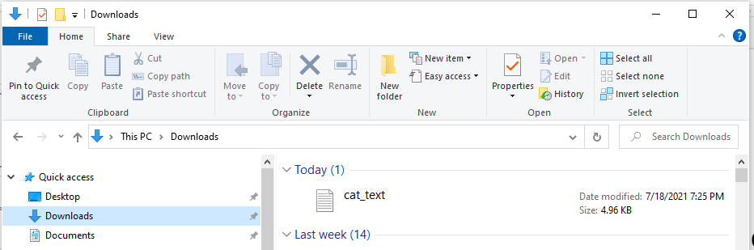
First, download the file to your computer.
Pay attention to where the download is saved

Slide 3
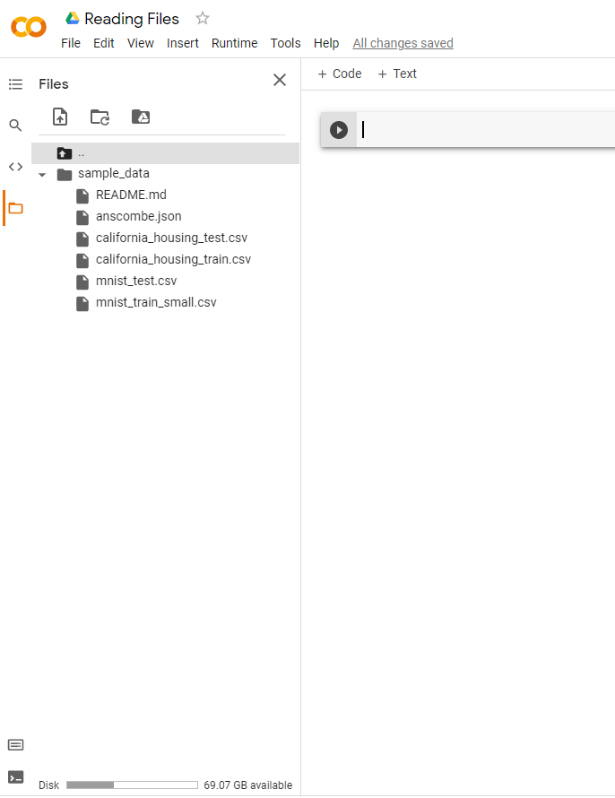
In google colab…
Open the “Files” menu from the side bar

Slide 4
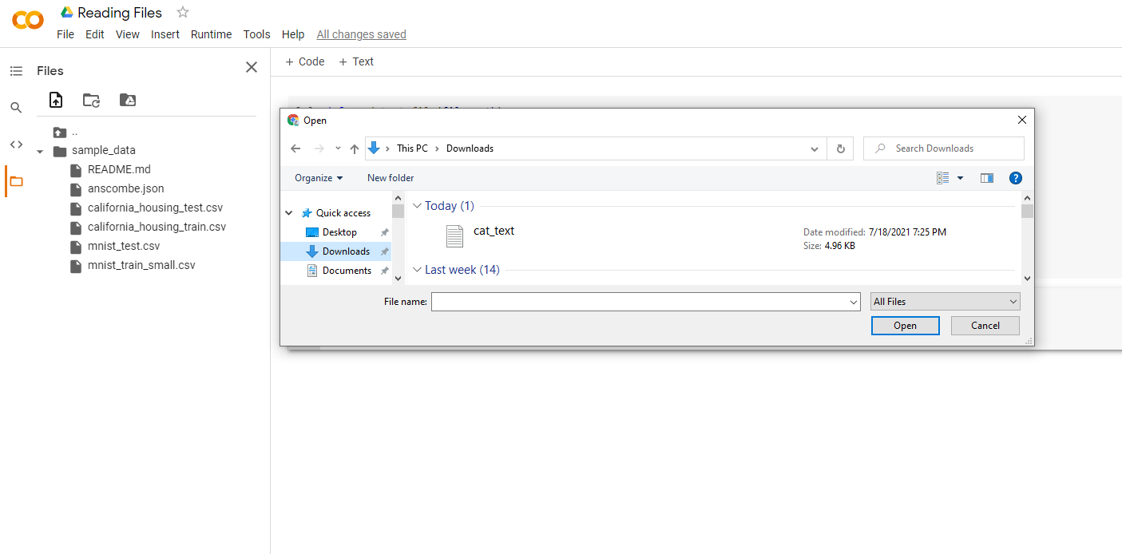
Click Upload to Session Storage…
Navigate to your downloaded file and click “Open”

Slide 5
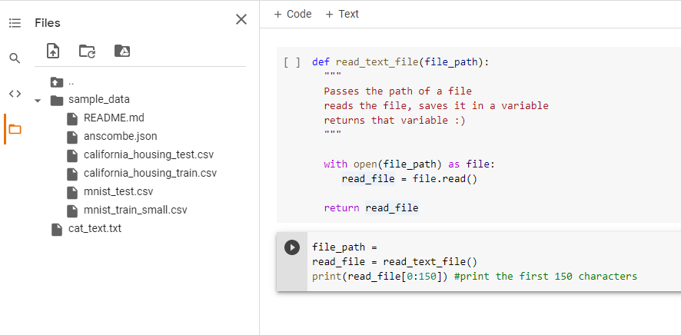
You should see your file in the Files menu

Slide 6
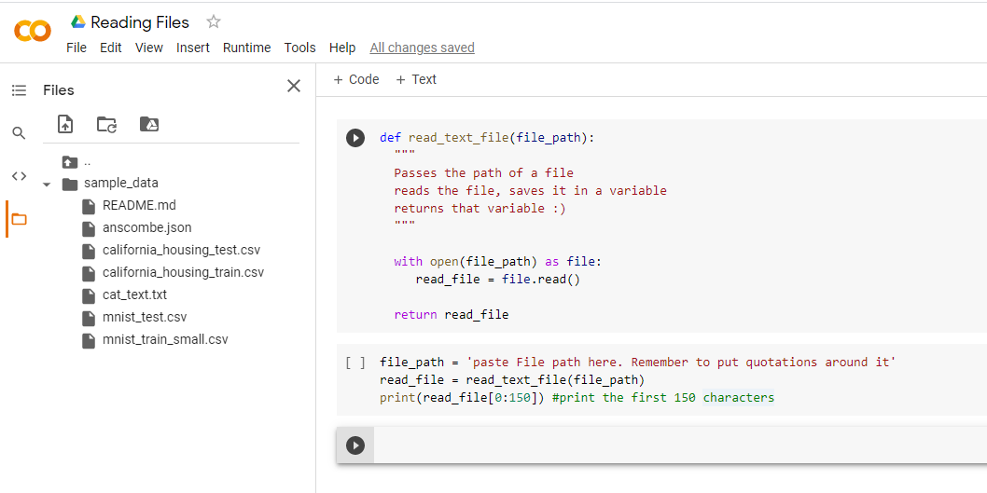
Move it into the sample_data folder.
Then, right click on the file and select copy path.

Slide 7
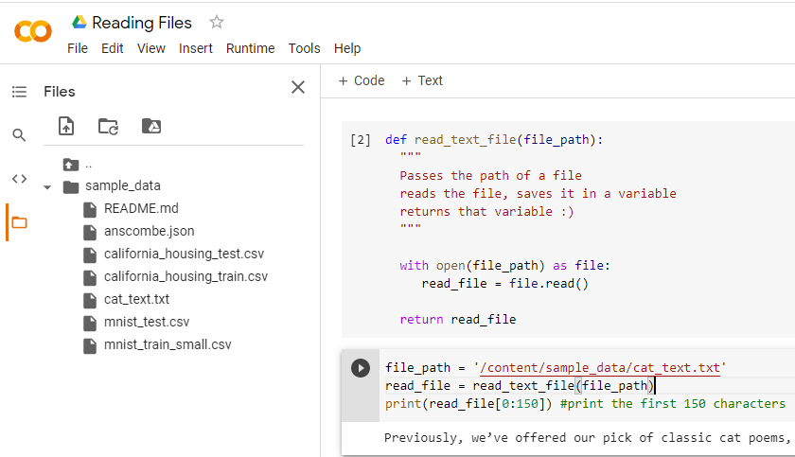
Paste the path into your code and you are set!

